Slide 1

Emoji-Based Text Compression
A Novel Approach for Conversational Chat Compression

Slide 2
Abstract
This project introduces an efficient, human-readable text compression method for chat messages.
Leverages a combination of a manually crafted seed dictionary and a dynamic, data-driven dictionary to substitute frequent phrases with emoji representations.
Reduces storage and transmission costs while ensuring chat remains interpretable and fully reversible.
Demonstrates substantial compression ratio improvement over traditional algorithms for chat-centric datasets.

Slide 3
Problem Description
Rapid growth in chat-based communication leads to massive text data needing efficient storage and transmission.
Traditional compression (e.g., Huffman, LZW) works at the character level and loses human interpretability.
Need for a method that compresses repetitive, semantically rich chat without sacrificing readability.
Goal: Compress frequent conversational patterns into compact, transparent emoji tokens.

Slide 4
Scope
Develop a hybrid emoji-based compression framework for conversational text data.
Achieve high compression ratios while retaining or improving interpretability.
Automate the discovery of dataset-specific phrases for adaptive compression.
Compare performance and usability with existing character-based models.
Ensure perfect reversibility (lossless decompression)

Slide 5
Objectives
Accuracy: Maximal phrase coverage with minimal loss in decompression fidelity.
Usability: Output must be intuitive, readable, and compatible with chat interfaces.
Efficiency: Compression and decompression run in real-time for live chat archives.
Adaptability: System dynamically extends emoji mappings for different datasets.
Maintainability: Easy update of dictionaries and extension to new language domains.

Slide 6
Methodology/Algorithm
Seed Dictionary: Manually constructs phrase-to-emoji mapping for frequent phrases.
Dynamic Dictionary: Automatically mines high-frequency n-grams and assigns unused emojis.
Compression Step: Applies both dictionaries, longest match first, for maximal substitution.
Decompression: Performs reverse lookup from emojis/tokens to original phrases.
Mathematical Operations: Phrase frequency analysis, mapping application, sequential substitution.

Slide 7
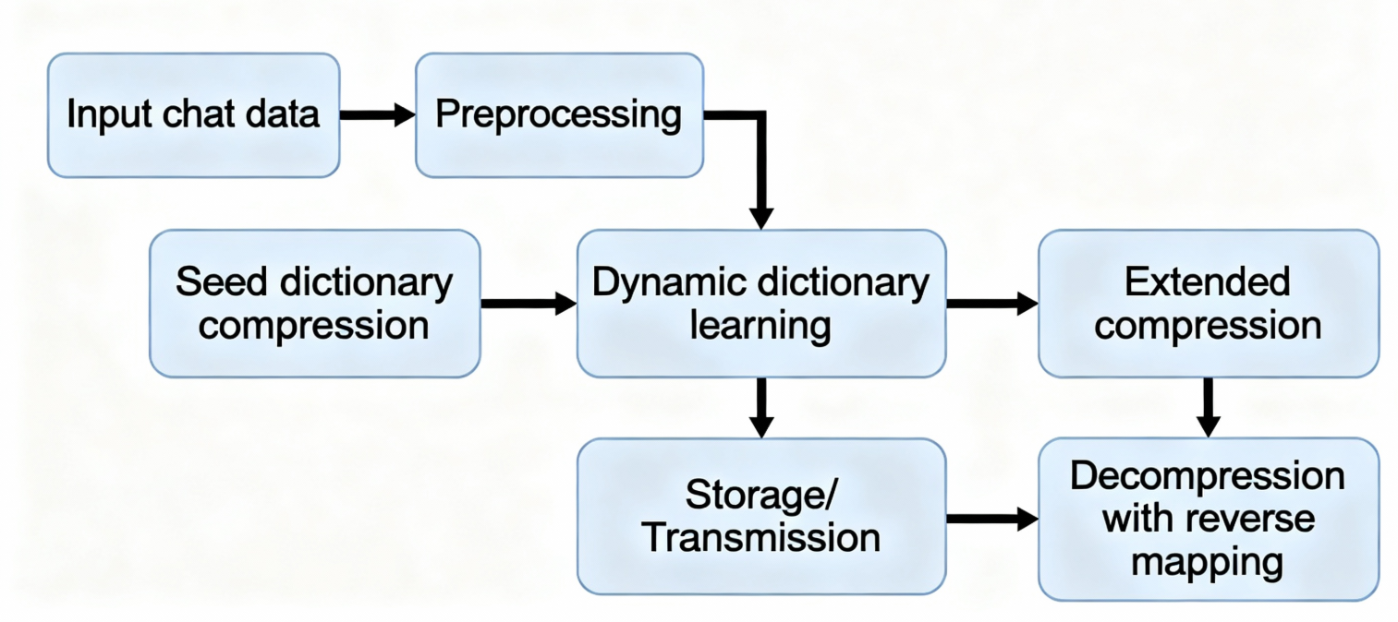
Architecture Diagram

Slide 8
Datasets Description
Collection of over 500 real-world chat messages from customer support scenarios.
Data includes timestamps, sender roles, and conversational content.
Preprocessing involves cleaning, removing sensitive info, and normalizing case.

Slide 9
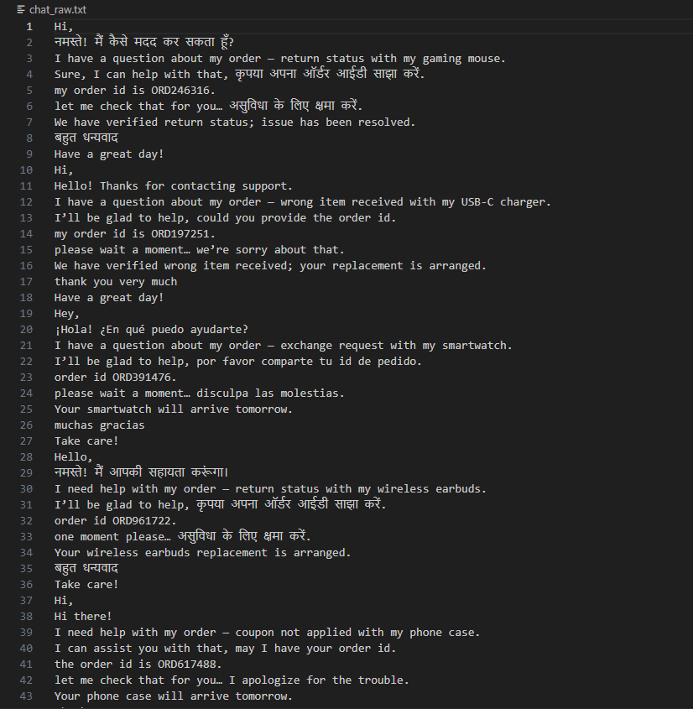

Slide 10
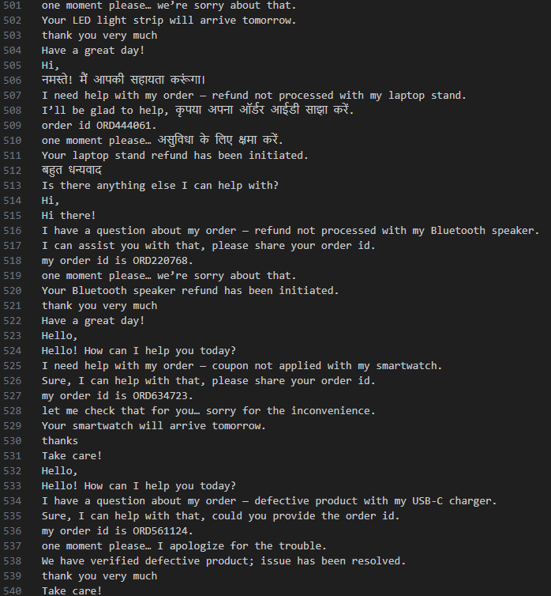

Slide 11
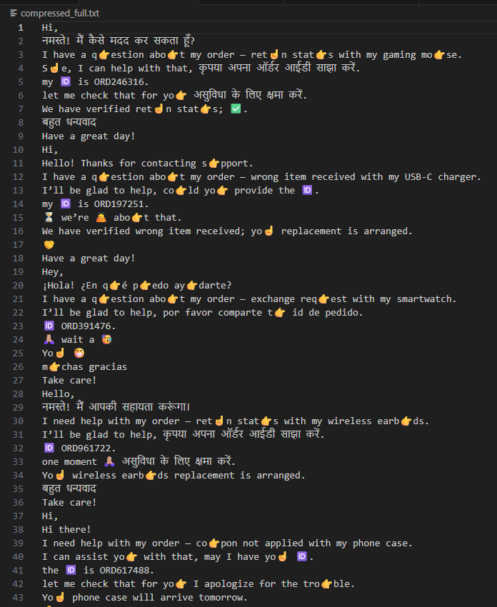
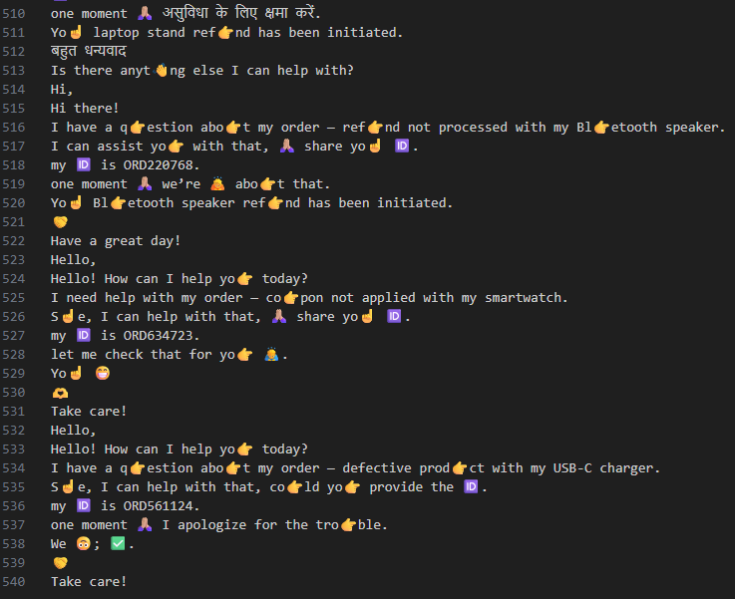
Result

Slide 12
Comparison with Existing Models
Feature | Emoji Compression | Huffman Coding
Compression Level | Phrase/word | Character
Readable Output | Yes | No
Semantic Meaning | Preserved | Not preserved
Adaptability | Dynamic/automatic | Static
Use Case | Chat/conversational | General
Reversibility | Yes | Yes

Slide 13
Conclusion
The emoji-based text compression framework presents a novel, human-readable approach to compressing conversational chat data by substituting frequently used phrases with semantically meaningful emoji tokens. This method combines a static seed dictionary with dynamic dictionary learning to adapt to specific datasets, resulting in significant data size reduction without loss of meaning or readability. Unlike traditional algorithms such as Huffman coding, this model operates at the phrase level, preserving semantic context and enabling easy, reversible decompression. The approach demonstrates both scalability and practical usability for real-time chat applications, offering valuable improvements for text storage, transmission efficiency, and user experience. Future enhancements could explore multilingual adaptability and integration of hybrid compression models for even greater efficiency.

